Slide 1
Significance of Incorporating Chebfun Coefficients in Improved Machine Condition Monitoring System
Sachin Saj T K (Mtech 1st Year), Dept. Computational Engineering and Networking, Amrita School of Engineering, Coimbatore

Slide 2
Objective:
To propose a feature dependent-machine condition monitoring system, by using chebfun coefficients and regularized least square classifier, for machine fault diagnosis.

Slide 3
Introduction:
For any rotating mechanical system bearing and gears are one of important parts.
A Machine Condition Monitoring System- helps in continuously monitor the heath of the system by collecting, processing and interpreting the data.
Through this system real-time operating machines can be monitored.
How does it work? – Vibrational analysis : All machines irrespective of their conditions have certain frequency of vibration whether the machines are running in good or fault conditions.
So we propose a system by using vibrational analysis and putting machine learning algorithm for pattern classification.

Slide 4
Existing Methods:
Features | Classifier | Fault Category | No-of Class
Statistical Features | Regularized Least Square | Bearing | 12
Cyclo-Stationary Features | Decision Tree | Bearing | 4
Cyclo-Stationary Features | Non- Probabilistic SMO | Bearing | 4
Cyclo-Stationary Features | Probabilistic SMO | Bearing | 4
Cyclo-Stationary Features | Regularized Least Square | Bearing | 4
Statistical Features | c-SVC | Bearing | 12
Statistical Features | nu-SVC | Bearing | 12
Statistical Features | PSVM | Bearing | 4
Statistical Features | J48 | Gear | 7
Statistical Features | NN | Ball Bearing | 3

Slide 5
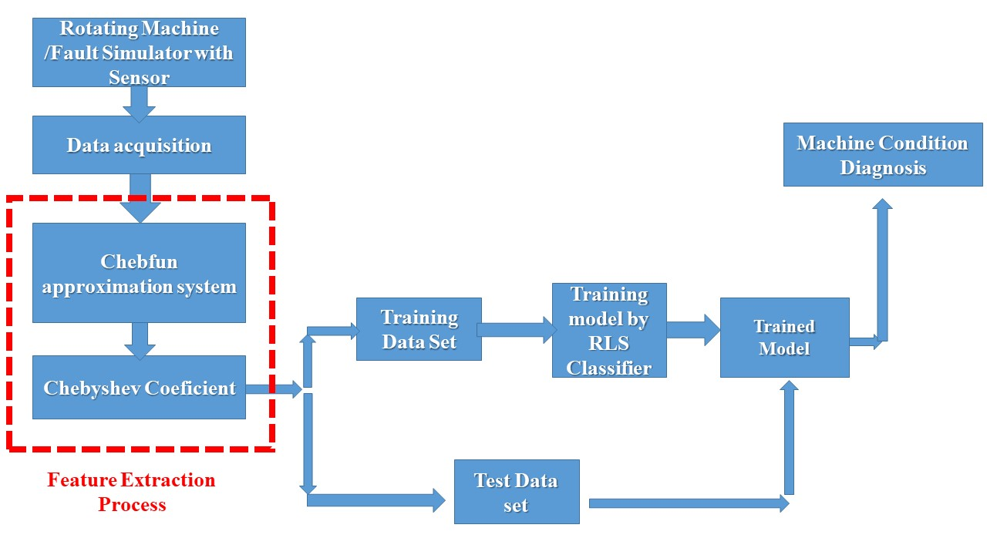
Proposed System:

Slide 6
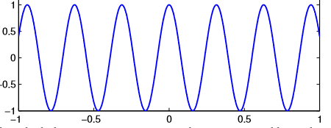
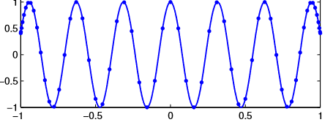
Chebfun System:
Chebfun system is tool used for numerical computation, written in matlab code.
In this, when the signal passed, it represents the signal in continuous function.
Continuous function is represented by chebyshev points and represents the whole signal without loosing the contents.
By this system, we can extract the features, which best suits in representing the signal and help in truncating the signal, which in turn reduces the computation.
Vibration Signal
Chebyshev Points

Slide 7
Regularized Least Square Classifier (RLS)
Regularized least square is a supervised machine learning algorithm, which is used for classification.
Notes:
We are using a regularized least square classification algorithm for classification task. In this methd we give the train data with corresponding labels and it will compute a weight matrix in a least square sense.

Slide 8
Regularized Least Square Classifier (RLS)
Regularized least square is a supervised machine learning algorithm, which is used for classification.
The weight matrix, W is computed as,

Slide 9
Datasets:
Bearing Dataset (Dataset-1) 4 Class Dataset : Class A : Good Condition. Class B : Inner race fault condition Class C : Outer race fault condition Class D : Inner and Outer race fault condition No of signals – 400 (100 each ) Sampling length : 8192
Gear Dataset (Dataset-2) 7 Class Dataset : Class A : 10% fault Class B : 20% fault Class C : 30% fault Class D : 40% fault Class E : 80% fault Class F : 100% fault Class G : expt no load No of signals – 420(60 each) Sampling length - 2047

Slide 10
Results : ( Classification accuracy for dataset-1)
Data Split | Kernel\ Coefficient | Accuracy (%) 10 20 30 40 50
20:80 | Linear | 97.5 | 98.54 | 98.03 | 98.75 | 95
 | RBF_HO | 97.5 | 98.12 | 95 | 97.5 | 98.33
 | RBF_LOO | 96.25 | 98.36 | 98.75 | 96.25 | 96
30:70 | Linear | 96.66 | 97.5 | 97.67 | 96.67 | 97.5
 | RBF_HO | 96.66 | 95.8 | 98.3 | 98.33 | 96.67
 | RBF_LOO | 96.66 | 97.5 | 98.33 | 96.67 | 97.5
40:60 | Linear | 96.87 | 97.5 | 95.62 | 96.25 | 97.5
 | RBF_HO | 96.87 | 96.87 | 96.85 | 96.25 | 98.12
 | RBF_LOO | 97.5 | 98.12 | 97.5 | 95 | 96.87
Notes:
So we obtain a signa which is represented by 10 cheshey pints

Slide 11
Results : ( Classification accuracy for dataset-2)
Data Split | Kernel\ Coefficient | Accuracy (%) 10 20 30 40 50
20:80 | Linear | 91.66 | 96.42 | 98.80 | 97.61 | 95.23
 | RBF_HO | 91.66 | 92.85 | 90.47 | 97.61 | 91.6
 | RBF_LOO | 92.85 | 96.42 | 90.47 | 91.66 | 95.23
30:70 | Linear | 95.23 | 96.03 | 92.85 | 92.85 | 94.44
 | RBF_HO | 84.12 | 85.71 | 86.50 | 92.06 | 92.06
 | RBF_LOO | 88.50 | 84.12 | 92.06 | 87.30 | 86.50
40:60 | Linear | 89.88 | 91.66 | 82.73 | 94.04 | 89.88
 | RBF_HO | 77.97 | 86.90 | 78.57 | 82.73 | 81.54
 | RBF_LOO | 82.73 | 80.95 | 85.71 | 83.92 | 82.73

Slide 12
Comparison of proposed system with existing approaches:
Features | Classifier | Kernel | Fault Category | No-of Class | Accuracy(%)
Statistical Features | Regularized Least Square | Radial Basis function(RBF) | Bearing | 12 | 96.67
Cyclo-Stationary Features | Decision Tree |  | Bearing | 4 | 94
Cyclo-Stationary Features | Non- Probabilistic SMO | Linear Polykernel | Bearing | 4 | 97.25
Cyclo-Stationary Features | Probabilistic SMO | Linear Polykernel | Bearing | 4 | 96.75
Cyclo-Stationary Features | Regularized Least Square | Radial Basis function(RBF) | Bearing | 4 | 96.45
Statistical Features | c-SVC | Linear Kernel | Bearing | 12 | 98.03
Statistical Features | nu-SVC | Linear Kernel | Bearing | 12 | 95.58
Statistical Features | PSVM |  | Bearing | 4 | 95
Statistical Features | J48 |  | Gear | 7 | 85.1
Statistical Features | NN |  | Ball Bearing | 3 | 95
Chebshey Coefficients | Regularized Least Square | Linear Kernel | Bearing | 4 | 98.75
Chebshey Coefficients | Regularized Least Square | Linear Kernel | Gear | 7 | 98.80

Slide 13
Conclusion:
The signiﬁcance of chebfun coefficients of vibration signals for machine condition monitoring is investigated.
The proposed system has achieved an accuracy of 98% for both bearing and gear fault classiﬁcation.
The performance is compared with several other existing approaches and the results are found to be satisfactory.
It is concluded that the proposed machine fault diagnosis system using chebfun coeﬃcients can be used as an eﬀective tool for real-time machine condition monitoring.

Slide 14
Reference :
S Sachin Kumar, Neethu Mohan, Prabaharan Poornachandran, and KP Soman. Condition monitoring in roller bearings using cyclostationary features. In Proceedings of the Third International Symposium on Women in Computing and Informatics, pages 690–697. ACM, 2015.
Neethu Mohan, PS Ambika, S Sachin Kumar, Murugan Sai M, and KP Soman. Multicomponent fault diagnosis using statistical features and regularized least squares. International Journal of Applied Engineering Research, 10(20):19074–19080, 2015
Luisa F Villa, An´ıbal Ren˜ones, Jose R Peran, and Luis J de Miguel. Statistical fault diagnosis based on vibration analysis for gear test-bench under non-stationary conditions of speed and load. Mechanical Systems and Signal Processing, 29:436–446, 2012.
V Sugumaran and KI Ramachandran. Fault diagnosis of roller bearing using fuzzy classiﬁer and histogram features with focus on automatic rule learning. Expert Systems with Applications, 38(5):4901–4907, 2011.
V Sugumaran, GR Sabareesh, and KI Ramachandran. Fault diagnostics of roller bearing using kernel based neighborhood score multi-class support vector machine. Expert Systems with Applications, 34(4):3090– 3098, 2008.
M Amarnath, V Sugumaran, and Hemantha Kumar. Exploiting sound signals for fault diagnosis of bearings using decision tree. Measurement, 46(3):1250–1256, 2013.
Athira Chandran, T Anjali, Neethu Mohan, and KP Soman. Overlapping group sparsity induced condition monitoring in rotating machineries. In International Conference on Soft Computing and Pattern Recognition, pages 409–418. Springer, 2016.
V Sugumaran, V Muralidharan, and KI Ramachandran. Feature selection using decision tree and classiﬁcation through proximal support vector machine for fault diagnostics of roller bearing. Mechanical systems and signal processing, 21(2):930–942, 2007.

Slide 15
Thank You

